Slide 1

Lottery Chain
ZHANG Xichen | 20527341
GU Chenghao | 20527420
CHEN Weili | 20528175
Notes:
I am glad to be here to present our project LuckyYou, one of the lottery game, is a revolutionizing way which based on blockchain technology.

Slide 2
Contains
Introduction
Framework of Lottery Chain
Smart Contract
DAPP & Demo
Business Plan
Summary and Improvements
Notes:
Let me and my teammates introduce them in detail.

Slide 3
Introduction
1

Slide 4
Background of Lottery Chain
By storing data across its peer-to-peer network, the blockchain eliminates a number of risks that come with data being held centrally. It is suitable for lottery because of its decentralisation.
People join the chain though P2P network. Anyone can buy arbitrary amount of unit lotteries and broadcast their transaction with a period of confirmation.
The fairness of the lottery chain is reflected in that everyone will make a consensus of the winner. The prize goes to the account of winner and the remain benefit goes to the account of beneficiary.
Notes:
By storing data across its peer-to-peer network, the blockchain eliminates a number of risks that come with data being held centrally. It is suitable for lottery because of its decentralisation. And we may achieve a goal with blockchain technology that everyone will admit the final winner and make sure that nobody can predict the final winner before the end of lottery.

Slide 5
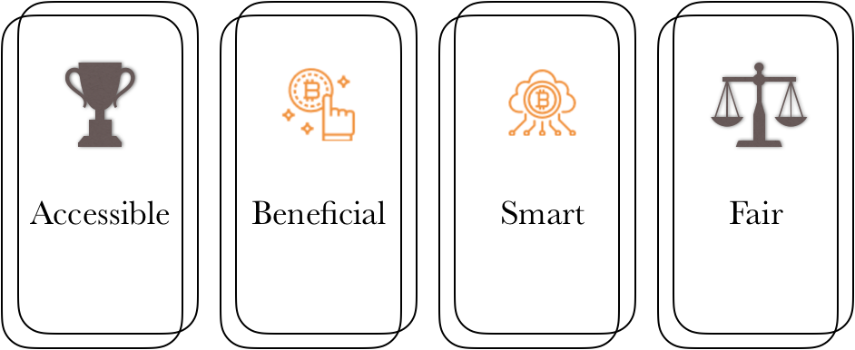
Advantages of Lottery Chain
Notes:
You know, lack of transparency and fairness, security and high costs are limitations of the development of the traditional lottery industry. Compared to traditional lottery, our luckyYou has advantages like:

Slide 6
Framework of Lottery Chain
2

Slide 7



Truffle Suite
Modules
Built in smart contract compilation, linking, deployment and binary management.
Deploying contracts, developing applications and run tests.
Collection of front-end libraries that make writing dapp frontends more predictable. Reactive Ethereum datastore for dapp users interfaces.
Functions
Smart contract: written by solidity
Dapp: wittern by angular.js
Truffle-contract encapsulates the web3.js, and web3.js encapsulates JSON_RPC, and can compile smart contract.
Notes:
We use Truffle suite to implement our project

Slide 8
Structure of Technology
Notes:
To be more specific, from up to down,
Dapp is wittern by angular.js
Smart contract is written by solidity
Truffle-contract encapsulates the web3.js, while web3.js encapsulates JSON_RPC, and it can compile smart contract.
Next, Xichen will introduce the logic of smart contract of LuckyYou.

Slide 9
Smart Contract
3

Slide 10
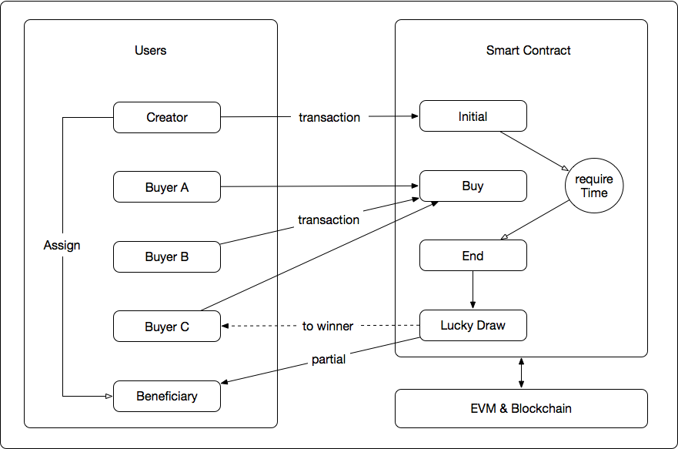
Interaction Logics
Notes:
As this graph shows there are 3 parties in this framework. Users, Smart Contract and EtherNet.
As we know, the smart contract is running on the EVM which could be seen as a black box for developers and App users. So most of the interactions we care happens between users and the contract.
There are 4 stages or functions in this lottery contract — Initial, Buy, End and Lucky Draw. Most ordinary users only need to use the Buy function to participate in the game while only the lottery creator will call the initial function once, to setup some basic attributes of this specific game instance. Attributes are like total time span of this game, beneficiary address, prize ratio. It will return the game address. Then everyone can join the game by using buy function, and sending their money ( here using ETH) to the contract. All the money from user will be added to the prize pool. When it comes the end, all functions will be disabled except the End function which will trigger the Lucky Draw to calculate the result and transfer the money to winner and beneficiary. After these processes, the contract will be forever disabled but also saved on the ethereum blockchain, and anyone can access its history buy checking variables in this contract address.

Slide 11
Smart Contract Logic
Validation of lottery: by setting lottery EndTime
Interaction: the prize was transferred after lottery EndTime (Premise: only winner & beneficiary addresses are valid)
Prize for winner: contract balance × winner_percent
Prize for beneficiary: contract balance - Prize for winner
Finding the winner: based on share, the more you purchase, the higher chance you can win.
Notes:
Besides, here are some important attributes and principle of the contract.
Firstly, the transactions can only be made within the lottery time span, once the lottery was ended, no one can make effective interaction with the contract anymore.
Secondly, the prize for winner and beneficiary are distributed upon the final balance of the contract and the pre-settled ratio by creator.
Finally, there is one principle of the winner selection, the more you purchase, the higher chance you will win.

Slide 12
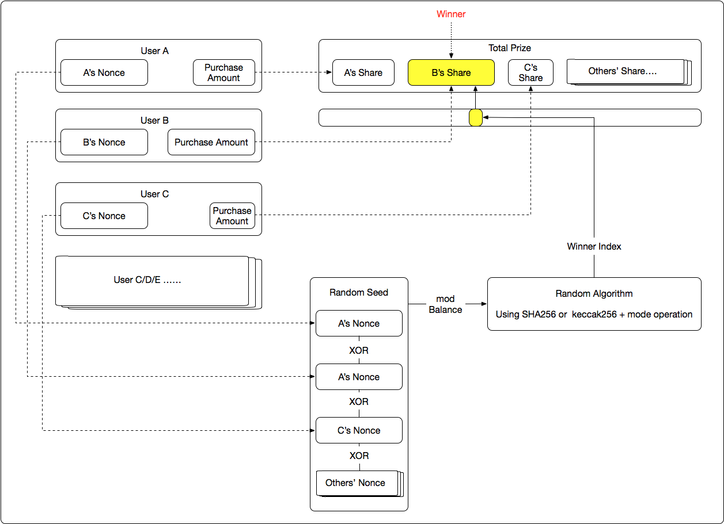
Winner Selection Logic
Notes:
This flow graph shows the underlie logic of winner selection and the mechanism of randomness in the contract. Firstly, each user holds their own purchases and nonce. The contract will arrange their winning probability according the ratio of money the invest and the total prize until the final moment. Each user will be assigned a range of index logically in order, whoever capture the final random number will be the winner.
Moreover, all the Nonce will be exclusive OR together with some other random value such as timestamp or blockIDs. And then, using it as the input to the built-in SHA256 algorithm to generate a bytes32 value, then cast it to int32 and then mod by the balance. That result is the winner index which helps to local the winner finally.

Slide 13
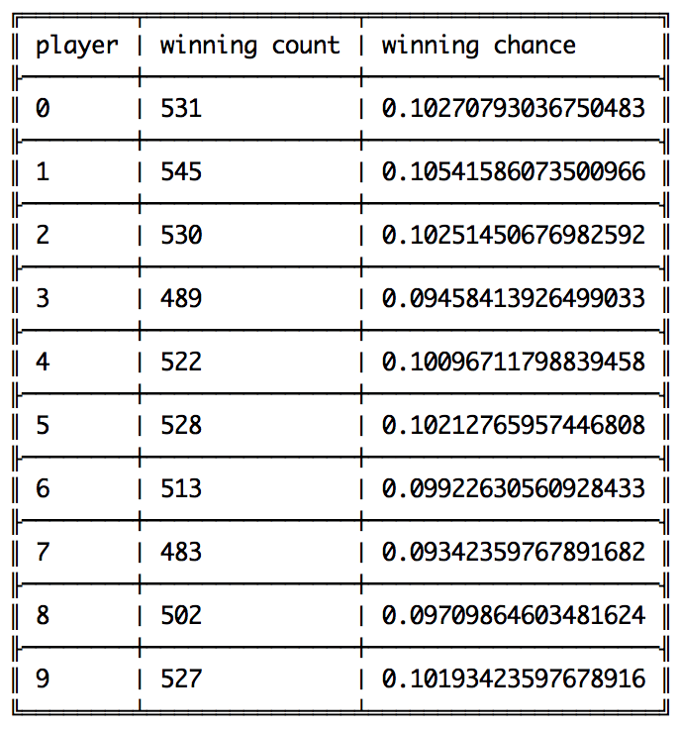
Fairness of Winner Selection
More than 5k times tests
Uniform distribution
Higher chance higher purchase
Notes:
To make sure the game is fair enough, we have tested the contract more than 5,000 times. For each time, users brought the same amount of lotteries, with random generated nonce (P.S. Here the random algorithm is using built-in random package of Node.js).
As the result shows, the winning chance of each user is roughly around 0.1. Hence, we believe the random number is uniformly distributed in certain degree. But before we put the contract in production, there are more work and test need to be done. Such as analysis the influence on the winning chance from final balance and the number of users.

Slide 14
DAPP & Demo
4

Slide 15
Video File Here. (Too large, deleted)

Slide 16
Finical Plan
5

Slide 17
Stages
Stage I: 0 - 3 months
Market Analysis
develop prototype
Stage II: 3 - 6 months
promote our product to lottery companies & government & foundations
improve and iterate the products
Notes:
We have a 2 stages development plan.
We’ll spend the first 3 months to develop the product to have more functionnality & better usebility. Meanwhile, analyzing the market at same time.
Then, in the next stage, we’ll reachout to the lottery companies / goverment and some welfare foundations to sell the platform and the support as well as the long-term development.

Slide 18
Financial Plan
Cost
Income
Equipment cost : 50,000 HKD
3 cloud servers
Personnel cost : 600,000 HKD
25,000 HKD / ( 4 employee x month)
Marketing cost : 50,000 HKD (Stage 2)
Initial Prize
Advertisement
Decuction of each Lottery Game : 500,000 HKD / month
5% of each round of lottery prize
Expected 1,000,000 users / month
Expected 10 HKD / user
Notes:
As for the financial plan, we’ll try to avoid hight invest in the begining. But we expect a stable income once the system is online. The main income will come from the commission of the lottery for each round.

Slide 19
Financial Plan
cost
income
revenue
Stage I
350k HKD
0
-350k HKD
Stage II
350k HKD
1,500k HKD
1,150k HKD

Slide 20
Summary and Improvements
6

Slide 21
Summary
Secure & Fair
Public welfare
Easy to use
Improvements
More playing modes
For now, each user can only buy once, we hope to extend to multiple times
Better random algorithm
lower interaction cost. - lower time complexity
Lottery List / A Fair Lottery Platform
Notes:
To sum up, for users, LuckyYou is secure, fair, and easy to purchase. However, LuckyYou needs improving in some aspects : first is to be various and can support more playing modes. Then, for now, each user can only buy once, we hope to extend to multiple times. And we may improve algorithm to decrease time complexity as well as interaction cost.

Slide 22
“Let Randomness Rules”
- LuckyYou
Notes:
One more thing, this is our slogan,

Slide 23
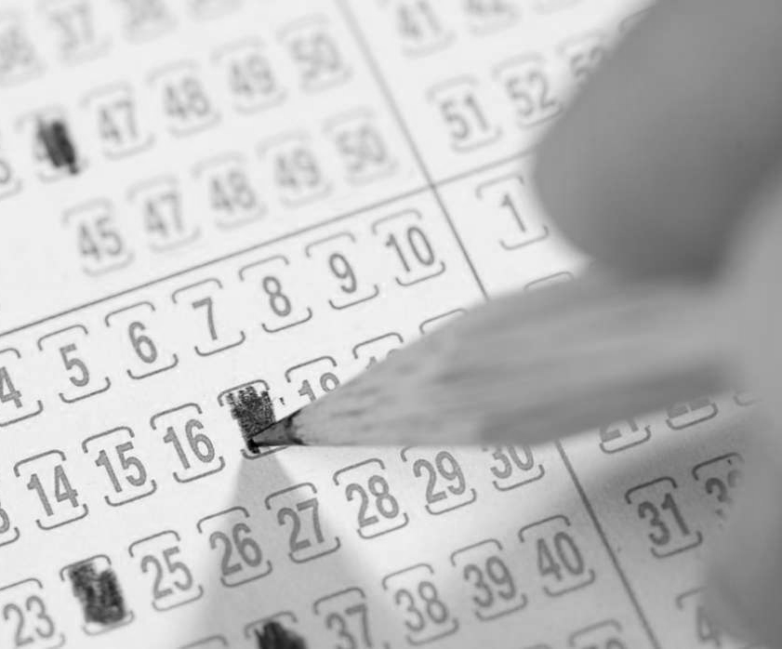
Thanks!
Code Link: https://github.com/cchencool/LuckyYou
Notes:
Thanks for your listening.

